Slide 1
Predictive Credit Risk Management
TEAM - 2
Project Mentor
Ms. Vibha Santhanam
AI Consultant
Project Members
Abhishek M
Anurag Singh
Saravanan G
Sriharan T
Syed Shayan Abid Hussain

Slide 2
Problem Definition
Challenge: Many individuals with limited or no credit history struggle to access fair loans, often falling victim to untrustworthy lenders.
Objective: Home Credit aims to broaden financial inclusion for the unbanked population by using alternative data (telco, transactional info) to assess borrowers’ repayment abilities and provide safer, tailored loan options.
Home Credit is seeking help to Enhance predictive models for better loan approval decisions and Ensure fair access for borrowers who can repay.

Slide 3
Problem Definition
Why it is a important problem?
The Importance of Accurate Loan Decisions : Inaccurate loan decisions can have serious financial consequences for banks.
Approving loans for defaulters can lead to significant losses and potentially push the bank towards bankruptcy.
Conversely, denying loans to trustworthy customers not only harms the clients but also results in a loss of valuable customers for the bank, impacting long-term profitability.

Slide 4
Suggested Solution and EDA
Suggested solution for the defined problem
Leveraged Exploratory Data Analysis (EDA) to identify patterns in customer behaviour
Developed a machine learning model to accurately predict loan defaulters and timely payers, improving risk management and decision-making processes.
Data sets considered
application_data
previous_application
POS_CASH_balance
credit_card_balance

Slide 6
Suggested Solution and EDA
Exploratory data analytics done
Extensive EDA has been done for all the datasets and useful inferences obtained will help us to find out the behavioural patterns of the clients thus assisting in classifying potential defaulters effectively.
Shape of Application Data : Rows – 307511, Features - 122
Shape of Previous Application: Rows – 1670214, Features – 37
Shape of POS Cash Balance: Rows – 10001358, Features – 8
Shape of Credit Card Balance: Rows – 3840312, Features – 23
Null values Treatment:
Columns with more than 40% null values were removed.
Remaining were imputed with median
Univariate, Bi-variate, Multi-variate analysis had been done.

Slide 7
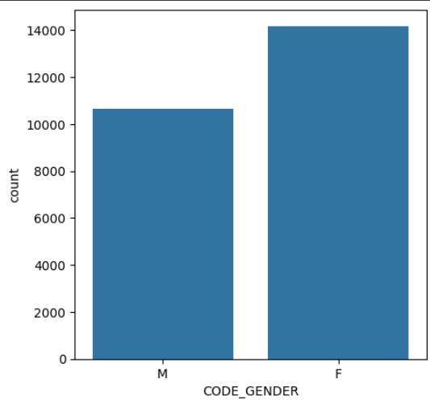
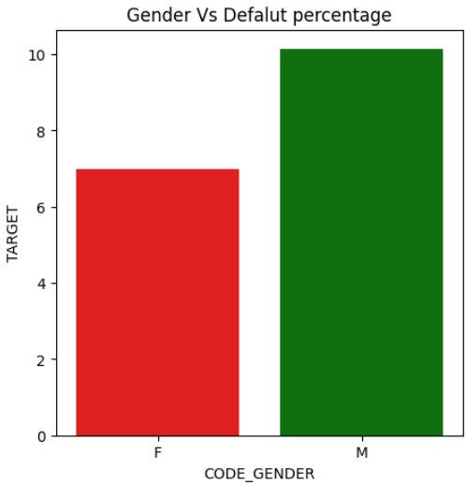
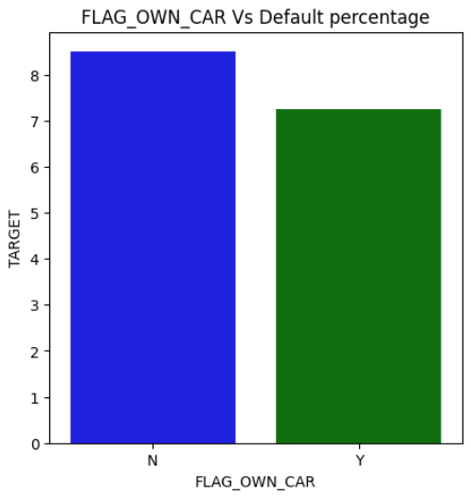
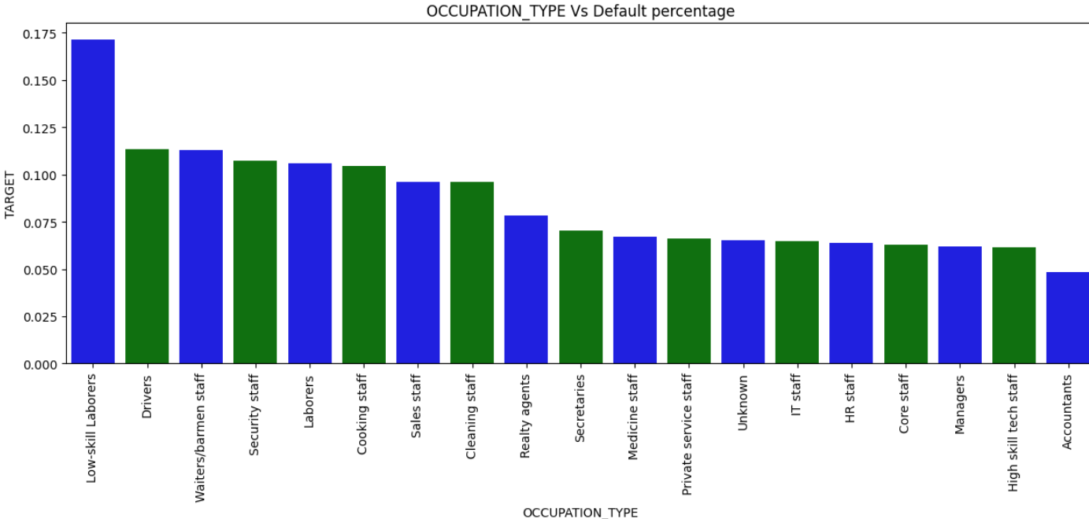
Suggested Solution and EDA

Slide 8
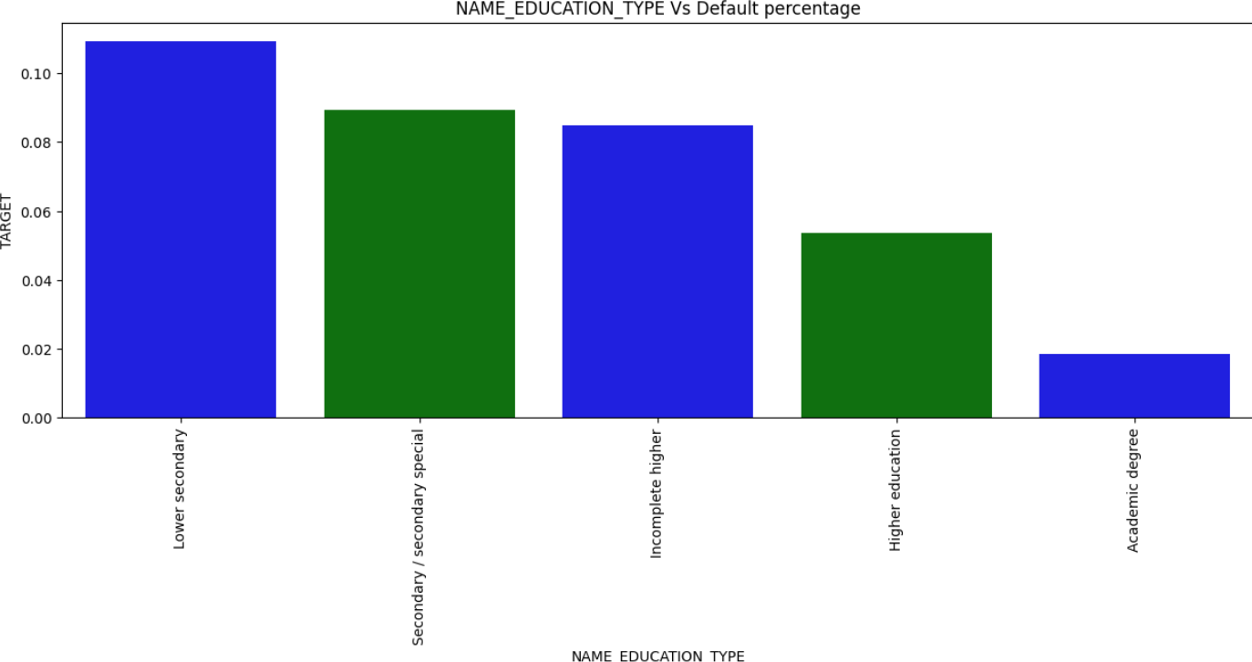
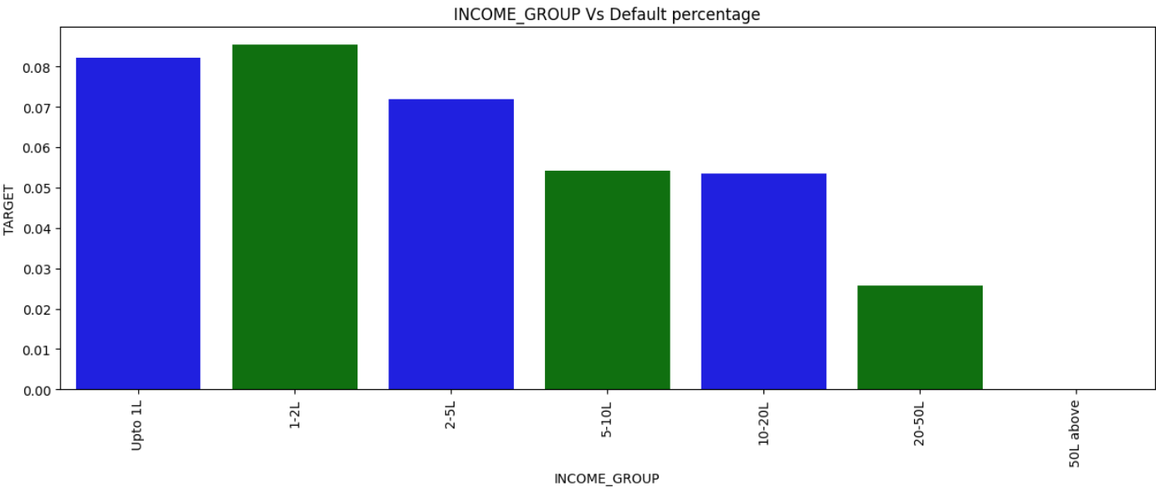

Slide 9
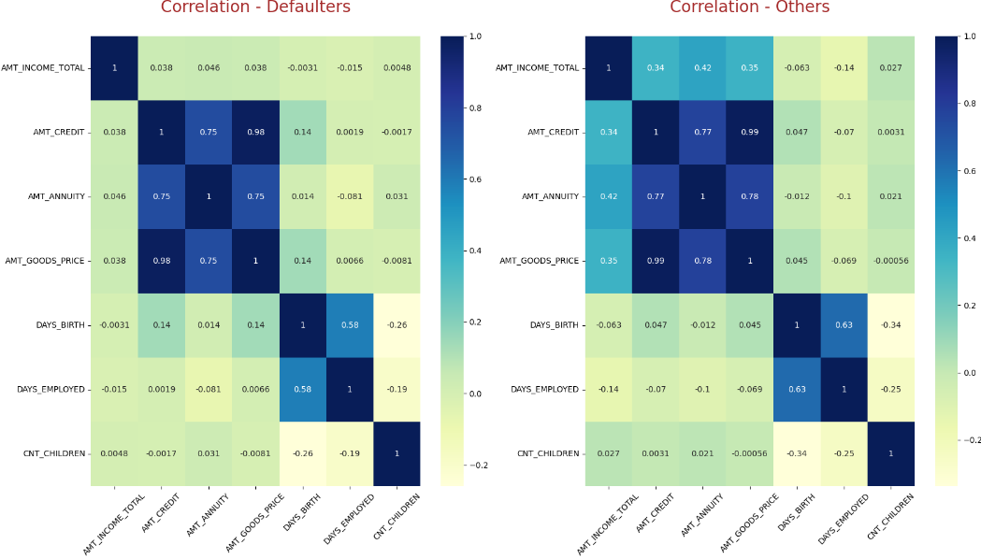

Slide 10
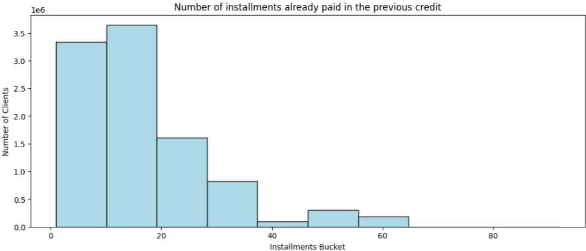
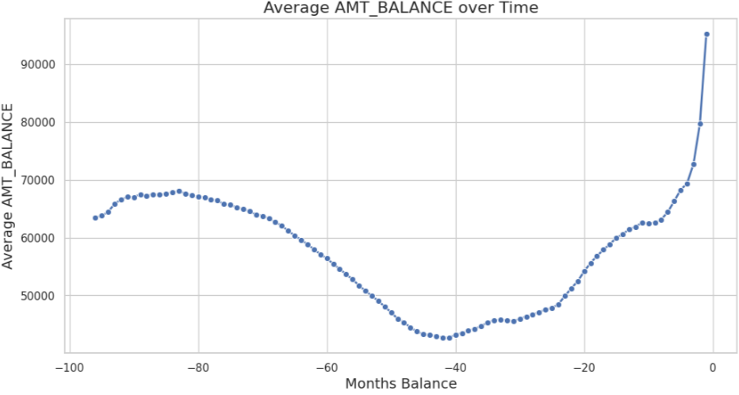

Slide 11
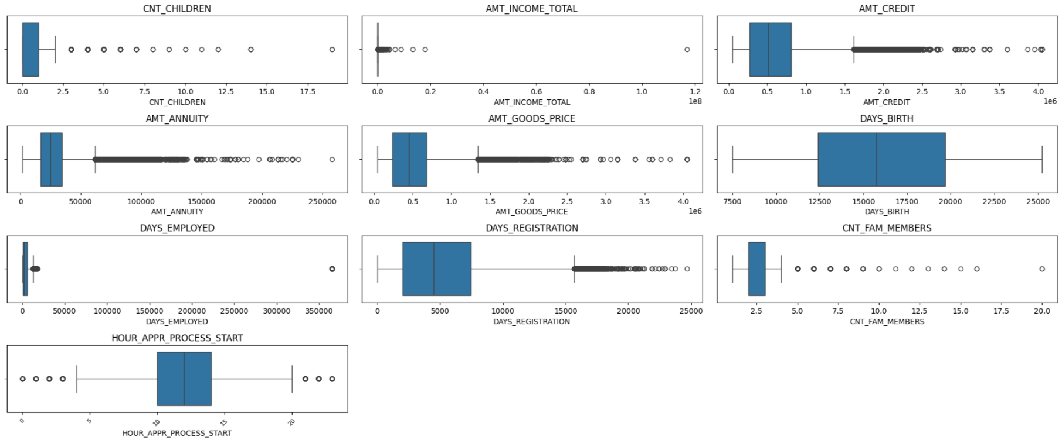
OUTLIER VISUALISATION
Outliers were present in our application data in some numerical columns, yeo-johnson transformation has been applied to reduce the effect of outliers.
Target encoding and one hot encoding were used to convert categorical columns into numerical columns.

Slide 12
Statistical Test
For Numerical Columns – Mann-whitney Test
For Categorical Columns - Chi 2 Contingency Test
Top 5 Numerical statistically important columns
DAYS_ID_PUBLISH
REGION_RATING_CLIENT_W_CITY
REGION_RATING_CLIENT
DAYS_REGISTRATION
EXT_SOURCE_2

Slide 13
Some Important EDA Inferences
- Young males with lower secondary education and of lower income group and staying with parents or in a rented house, applying for low-range cash contract, should be denied.
- Females are likely to repay but not if they are on maternity leave. Hence, bank can reduce the loan amount for female applicants who are on maternity leave.
- Since people taking cash loans for repairs and urgent needs are more likely to default, bank can refuse them.
- Since the people who have unused offers are more likely to default even though they have comparatively high total income, they can be offered loan at a higher interest rate.
- Banks can target businessmen, students and working class people with academic degree/ higher education as they have no difficulty in repayment.
- Bank can also approve loans taken on purpose for buying home or garage as there less chances of defaulting.

Slide 14
Any challenges expected/addressed
The dataset was very huge containing 3 lakh rows in all of them.
Missing Data: Significant missing values, particularly in OCCUPATION_TYPE (31%) ​​. Columns with over 40% missing data were dropped, but this led to information loss.
Imbalanced Target: The dataset was heavily imbalanced, with ~92% non-defaultersThis made it challenging to train models without overfitting.
Skewed Data: Features like AMT_INCOME_TOTAL and AMT_CREDIT were highly skewed due to outliers, complicating model performance​.
Negative Values: Time-related columns (e.g., DAYS_EMPLOYED) had negative values, which had to be converted to absolute values for clarity
Categorical Variables: Variables like ORGANIZATION_TYPE had many levels, increasing complexity in encoding​.
Multicollinearity: High correlation between variables (e.g., AMT_CREDIT and AMT_GOODS_PRICE) needed careful handling​.
Outliers: Extreme values in columns like DAYS_EMPLOYED (e.g., 365,243 days) distorted model predictions​.
Feature Engineering: Creating new features like CREDIT_INCOME_PERCENT was complex but necessary to improve model performance.

Slide 15
Algorithms considered with pros and cons
Model/Technique | ROC-AUC Score | Pros | Cons
Logistic Regression - Base Model | 0.60 | - Simple to implement - Interpretable model - Good for binary classification | - Struggles with complex, non-linear relationships - Low performance in this case (ROC-AUC = 0.60)
Decision Tree (Base) | 0.54 | - Easy to visualize - Handles both numerical and categorical data well | - Prone to overfitting - Performance lower than Logistic Regression (ROC-AUC = 0.54)
Decision Tree (Tuned) | 0.71 | - Improved performance after tuning - Handles overfitting better than base | - Still subject to overfitting for large, complex datasets
Bagging (Random Forest) | 0.73 | - Reduces overfitting - Improves generalization by combining multiple trees - Robust and less prone to variance | - Computationally expensive - Requires tuning to achieve optimal performance
Random Forest (Tuned) | 0.747 | - Better handling of overfitting - Improved recall and accuracy after tuning | - Lower recall for class 1 compared to Decision Tree model
Boosting (XGBoost) | 0.756 | - Works well with imbalanced datasets - Strong performance improvements with boosting techniques | - Susceptible to overfitting if not properly tuned - Computationally expensive
Boosting (LightGBM) | 0.76 | - Handles large datasets efficiently - Fast training - Best performance (ROC-AUC = 0.76) | - Requires careful hyperparameter tuning - Harder to interpret than simpler models
Computational Limitations | N/A | - Acknowledged the challenge in running hyperparameter optimization due to large dataset size | - Prevented full model optimization via GridSearchCV due to constraints

Slide 16
Algorithms, Solution and Conclusions
Model Evaluation and Improvement Process
Logistic Regression - Base Model
We initially trained a Logistic Regression model, achieving an ROC-AUC score of 0.60 on our Kaggle dataset. This score indicated room for improvement in our model’s performance.
Ensemble Techniques
To enhance our model, we decided to explore ensemble techniques, starting with Decision Trees as our base model.
Decision Tree Performance
The Decision Tree model yielded a disappointing ROC-AUC score of 0.54, which was lower than our Logistic Regression model. However, after hyperparameter tuning, we improved the ROC-AUC score to 0.71, with recall scores of 0.65 for class 1 and 0.66 for class 0.
Addressing Overfitting
Given that our Decision Tree model exhibited slight overfitting (with a training accuracy of 0.67 and a test accuracy of 0.66), we opted to implement a Bagging technique using Random Forest Classification to mitigate this issue.

Slide 17
Model Evaluation and Improvement Process
Random Forest Performance
With default hyperparameters, the Random Forest model achieved a ROC-AUC score of 0.73.
Hyperparameter Tuning for Random Forest
After tuning the hyperparameters of the Random Forest model, we obtained a ROC-AUC score of 0.747, along with improved recall scores of 0.73 for class 0 and 0.64 for class 1. However, the recall for class 1 was still lower compared to the Decision Tree.
Boosting Techniques
To further improve performance, particularly given the imbalanced nature of our target variable, we explored boosting techniques. We implemented XGBoost, which resulted in a ROC-AUC score of 0.756, with recall scores of 0.69 for both classes.
LightGBM Implementation
Finally, we employed LightGBM, which is well-suited for large datasets. This model achieved the highest ROC-AUC score of 0.76, with a recall of 0.69 for class 1, outperforming the other models.
Computational Limitations
Due to the large size of our dataset, we faced computational constraints that prevented us from performing GridSearchCV for hyperparameter optimization.

Slide 18
Algorithms, Solution and Conclusions
Logistic Regression
Logistic regression is a simple yet powerful algorithm for binary classification, making it ideal for predicting loan defaulters.
Logistic regression serves as a strong baseline model for classification tasks, and it’s easy to implement.
It’s faster than many complex models, allowing quick iterations and evaluations
The coefficients can help understand the importance of different features, useful for making data-driven decisions.

Slide 19
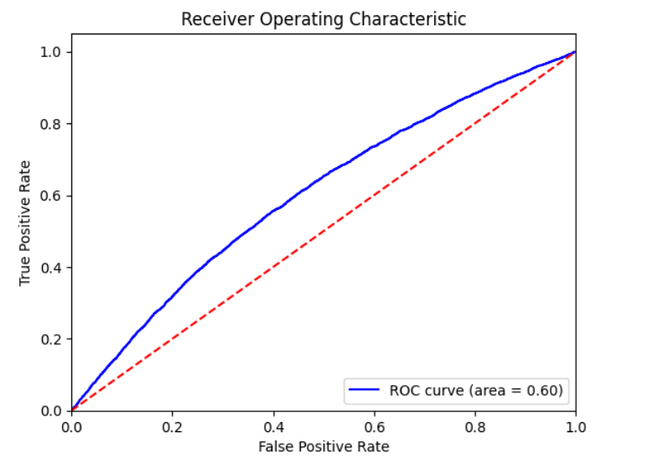
Results
After fitting the logistic regression model it gave ROC AUC score as 0.60
It gave a recall for defaulters as 0.55
This score indicates that the model has limited ability to distinguish between defaulters and non-defaulters.
The recall of 0.55 means that the model correctly identifies 55% of the defaulters, which implies it misses 45% of the actual defaulters.

Slide 20
Algorithms, Solution and Conclusions
Decision Tree Classifier
Decision trees can model complex, non-linear relationships between features and the target variable
No Assumption of Linearity and it Handles Missing Data
Decision trees can easily overfit the training data, especially with large datasets, unless pruning or limiting tree depth is applied.
For very large datasets, decision trees can become slower to train and more memory-intensive compared to logistic regression

Slide 21
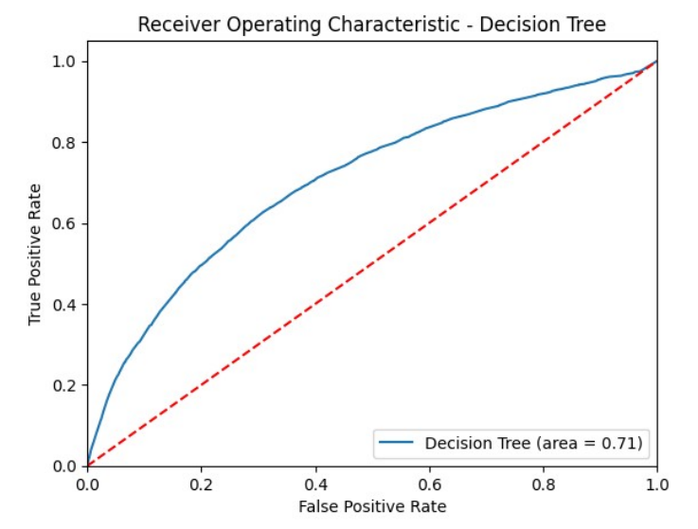
Algorithms, Solution and Conclusions
Decision Tree Classifier
Results
After fitting the Decision tree model it gave ROC AUC score as 0.71 with
hyper parameteers criterion=gini',max_depth=9,min_samples_split=3,min_samples_leaf=3,class_weight='balanced'
It gave a recall for defaulters as 0.65
This is an improvement over the logistic regression model (which had a ROC AUC of 0.60), suggesting that the Decision Tree captures more complex patterns in the data.
The recall of 0.65 means that the model correctly identifies 65% of the defaulters, which implies it misses 35% of the actual defaulters.

Slide 22
Algorithms, Solution and Conclusions
Random Forest Classifier
Random Forest combines the predictions of multiple decision trees, reducing overfitting and capturing more complex patterns in the data.
By averaging multiple trees, Random Forest reduces the risk of overfitting, making it more robust for complex datasets.
Random Forest handles missing data better and is more effective with imbalanced datasets, especially with class weighting or sampling techniques.
Random Forests require more time and computational resources to train, especially with large datasets like Home Credit.

Slide 23
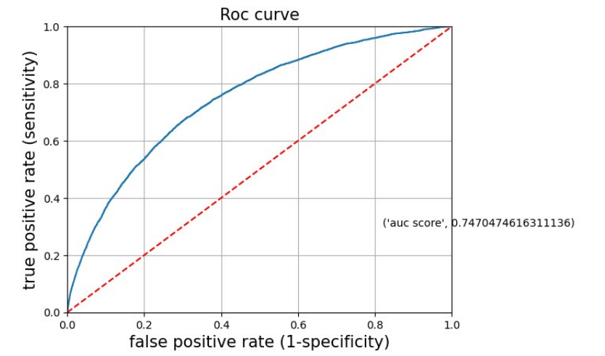
Algorithms, Solution and Conclusions
Random Forest Classifier
Results
After fitting the Random forest model it gave ROC AUC score as 0.747 with
hyper parameteers n_estimators=500, criterion=entropy,max_depth=9,min_samples_split=5,min_samples_leaf=2,class_weight='balanced'
It gave a recall for defaulters as 0.64
This is an improvement over the Decision tree model (which had a ROC AUC of 0.71), suggesting that Random forest captures more complex patterns in the data.
The recall of 0.64 means that the model correctly identifies 65% of the defaulters, which implies it misses 36% of the actual defaulters.

Slide 24
Algorithms, Solution and Conclusions
XG Boost Classifier
XGBoost is a powerful boosting algorithm that often outperforms simpler models like logistic regression on structured/tabular data.
XGBoost uses boosting to improve prediction performance by sequentially building trees that focus on correcting errors from previous iterations, leading to better accuracy.
XGBoost can handle class imbalance better by using techniques like custom loss functions or adjusting the scale_pos_weight parameter.
XGBoost has a large number of hyperparameters (e.g., learning rate, max_depth, subsample, etc.), and optimizing them can be time-consuming and complex.

Slide 25
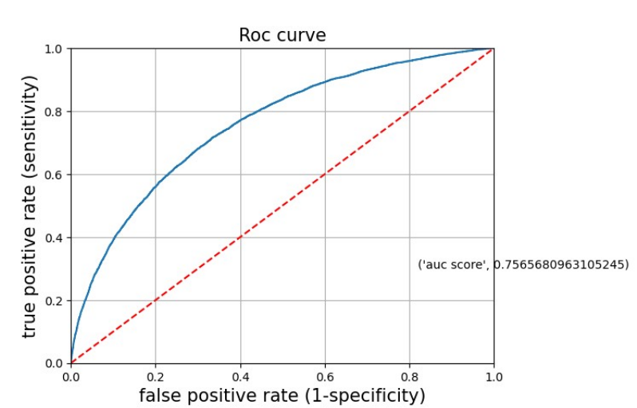
Algorithms, Solution and Conclusions
XG Boost Classifier
Results
After fitting the XG Boost model it gave ROC AUC score as 0.7565
It gave a recall for defaulters as 0.69
This is an improvement over the Random forest model (which had a ROC AUC of 0.747), suggesting that XG Boost captures more complex patterns in the data.
The recall of 0.69 means that the model correctly identifies 69% of the defaulters, which implies it misses 31% of the actual defaulters.
Best_params = { 'objective': 'binary:logistic', 'scale_pos_weight': sum(ytrain == 0) / sum(ytrain == 1), # Handle imbalance 'eval_metric': 'aucpr', # Precision-Recall AUC 'max_depth': 3, # Control overfitting 'min_child_weight': 6, # Regularization 'gamma’ # Prevents overfitting (pruning) : 4, # Regularization 'lambda': 1.0, # L2 regularization 'learning_rate': 0.1, # Lower learning rate for better generalization 'n_estimators': 100 }

Slide 26
Algorithms, Solution and Conclusions
Lightgbm Classifier
LightGBM is specifically optimized for efficiency and speed on large datasets.
LightGBM is highly optimized for speed and can handle large datasets with many features and samples much faster than logistic regression and even XGBoost.
LightGBM has built-in handling for imbalanced datasets, allowing you to adjust for class imbalance without extensive preprocessing
If not carefully tuned or regularized, LightGBM can overfit, particularly when the dataset is small or noisy. Regularization techniques and early stopping are often necessary.

Slide 27
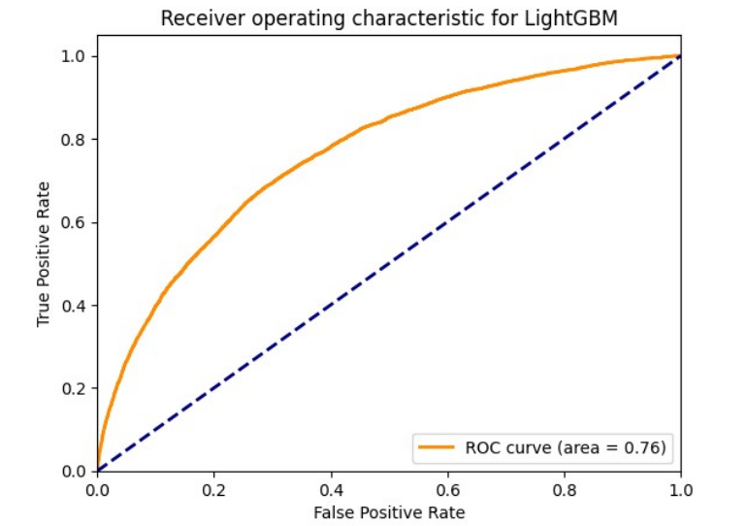
Algorithms, Solution and Conclusions
Lightgbm Classifier
Results
After fitting the XG Boost model it gave ROC AUC score as 0.76
It gave a recall for defaulters as 0.69
This is an improvement over the XG Boost model (which had a ROC AUC of 0.75), suggesting that Lightgbm captures more complex patterns in the data.
The recall of 0.69 means that the model correctly identifies 69% of the defaulters, which implies it misses 31% of the actual defaulters.
Best Parameters: {'learning_rate': 0.05, 'max_depth': -1, 'min_child_samples': 40, 'n_estimators': 200(no of boosting iterations), 'num_leaves': 31(no.of leaves each tree should have)}
Best AUC Score: 0.7580634277326599

Slide 28
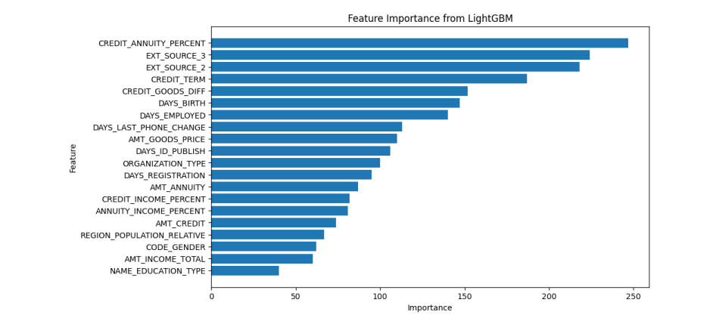

Slide 29
Conclusions
Best Model: LightGBM is the top-performing model with the highest ROC AUC, making it the best choice for predicting loan defaulters efficiently.
Both Random Forest and XGBoost also perform well, with ROC AUC scores of 0.75. They are reliable choices if interpretability is less of a concern.
Business Impact: LightGBM, along with Random Forest and XGBoost, enhances the ability to identify defaulters, improving risk management and financial decision-making. They outperform simpler models by effectively modeling complex data relationships.

Slide 30
Thanks!

